Slide 1
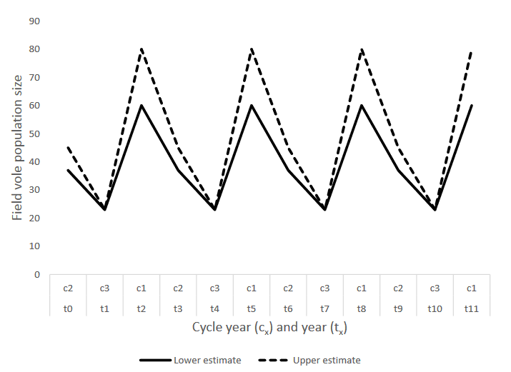
Estimating vital rates
Using Open CMR to estimate survival rates

Slide 2

What is a closed population?
First survey
Time between surveys
Second survey
If a population is closed, we assume that no reproduction or death occurs (requirement for estimating population size)

Slide 3
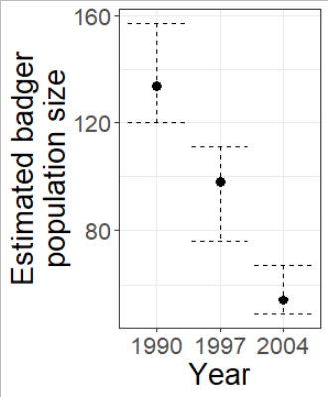
You’ve estimated population size, now what?
Say the population size is decreasing
We can calculate the trend
E.g. Badger population declined by 59.7% from 1990 to 2004
But the question should now be;
Why is this badger population declining and
What is the cause of the decline?

Slide 4

What is an open population?
First survey
Time between surveys
Second survey
If a population is open, we assume that reproduction or death occurs (more on this next week)

Slide 5
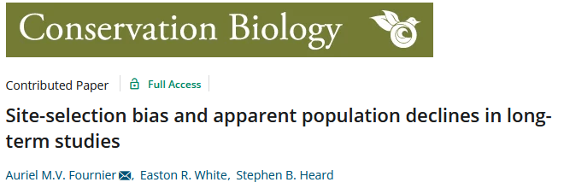
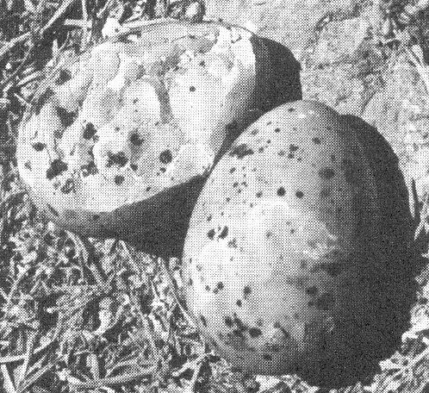
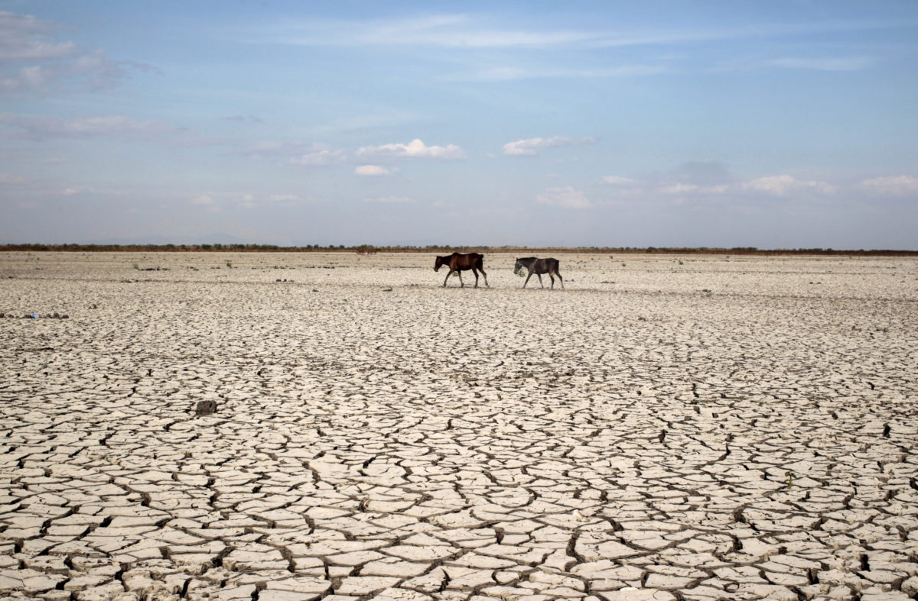
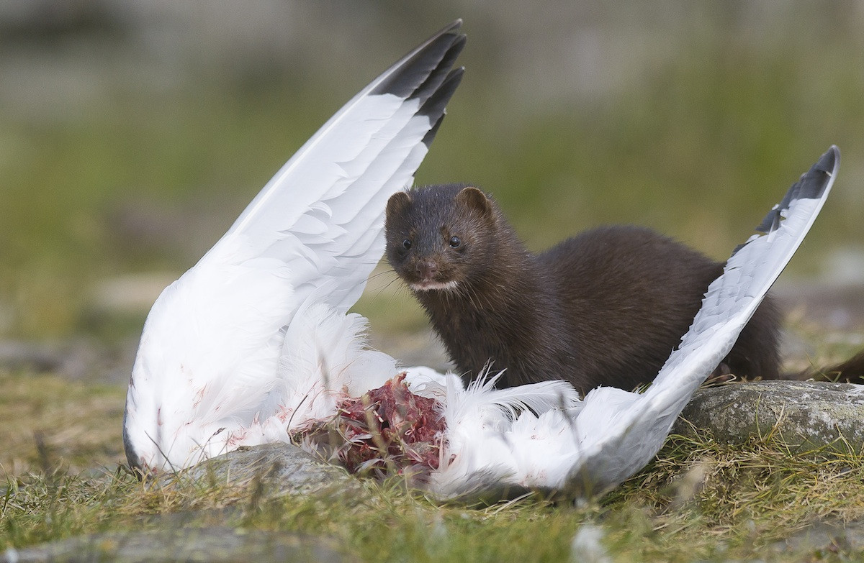
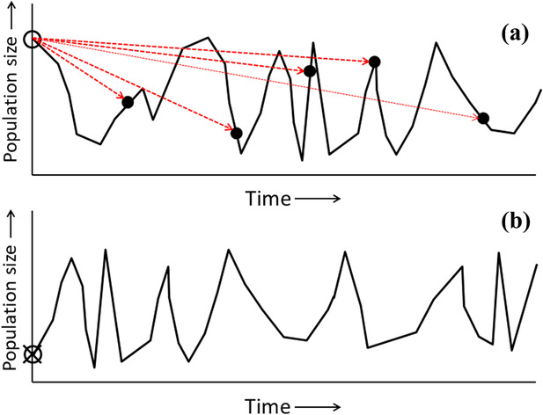
What is the cause of a population decline?
Many potential causes of population declines;
Drop in survival (a.k.a. an increase in mortality)
You are less likely to survive from one year to the next
Decrease in fecundity
You produce fewer offspring
And/or, for egg layers, the eggs you produce do not hatch
Decrease in immigration/increase in emigration
The study site is no longer attractive
(Hard to figure this out without GPS/radio collars)
Regression to the mean
Scientists often choose a site because there are many animals
Over the years, the population size will decline to the overall average

Slide 6
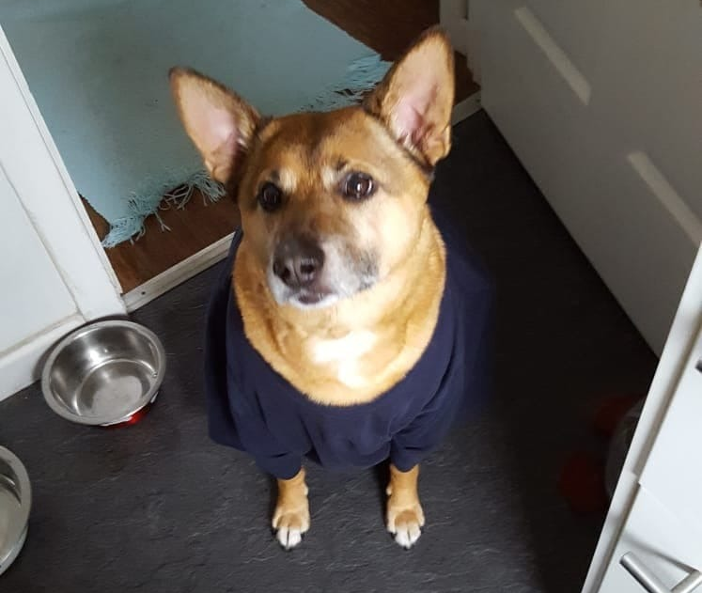
My dog’s life
2018
2019
2020
2021
2022
2023
2024
2025
Φ
Φ
Φ
(1-Φ)
Alive
Dead
Stochastic process (i.e. a biased coin flip)
Φ
Survival probability (i.e. the probability of the biased coin flip)
Deterministic process (i.e. certain)

Slide 7
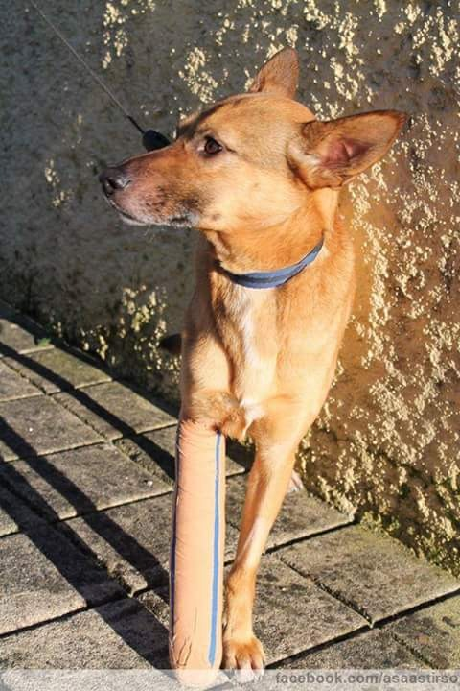
A state-space model
Animals can transition from one state to another
I.e. from an alive state to a dead state
But never dead to alive (finger’s crossed)
Open CMR models are called state-space models
Data is very similar to closed CMR, e.g.,
Could be written as 11110000
2018
2019
2020
2021
2022
2023
2024
2025
Φ
Φ
Φ
Φ
Alive
Dead

Slide 8
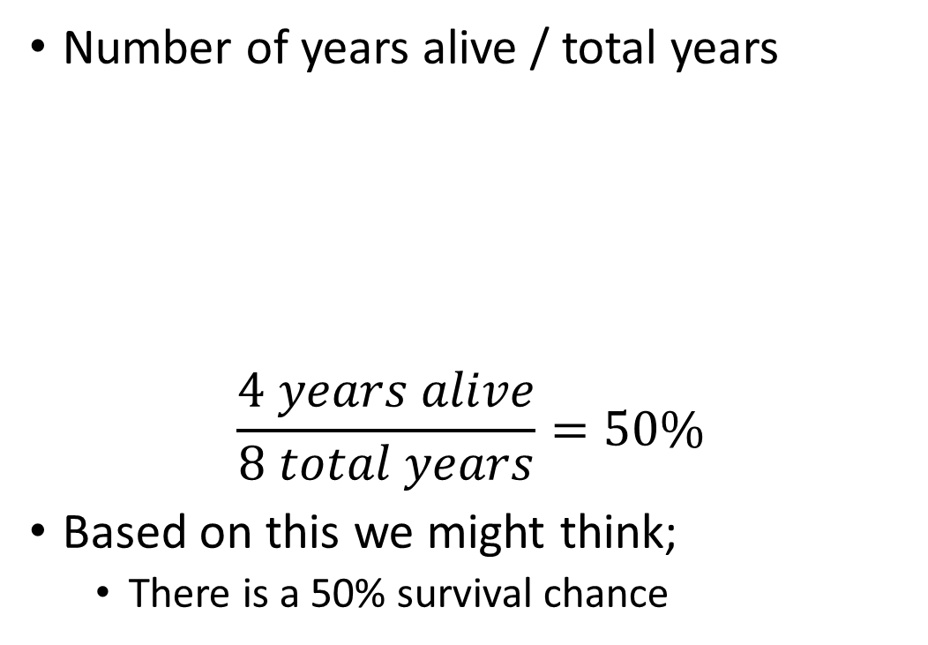
How do we calculate survival?
Number of years alive / total years
$$\frac{4 years alive}{8 total years}=50\%$$
Based on this we might think;
There is a 50% survival chance
2018
2019
2020
2021
2022
2023
2024
2025
Φ
Φ
Φ
Φ
Alive
Dead

Slide 9
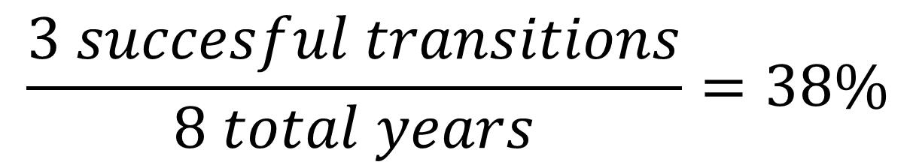
Lots of problems with this approach
Survival (Φ) is a transition probability
So we don’t care how many years an animal was alive
We care if they successfully transitioned (i.e. survived) from one year to the next
So the number we care about is number of transitions, not years alive
2018
2019
2020
2021
2022
2023
2024
2025
Φ
Φ
Φ
Alive
Dead
$$\frac{3 succesful transitions}{8 total years}=38\%$$

Slide 10
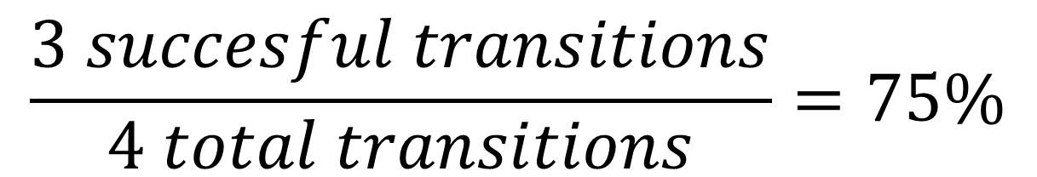
Next problem
If survival probability is 38%
There is a 2% chance that Pear would survive 4 years
Φ * Φ * Φ * Φ
Or Φ⁴
Or a 86% chance Pear would die after 2 years
1 – (Φ * Φ)
Or 1 – Φ²
Doesn’t seem likely
The mistake is to assume 8 years
Death is deterministic
There is no longer any probability
Now chance to survive 4 years is,
Φ⁴ = 0.75⁴ = 31%
2018
2019
2020
2021
2022
2023
2024
2025
38%
38%
38%
38%
Alive
Dead
$$\frac{3 succesful transitions}{4 total transitions}=75\%$$

Slide 11
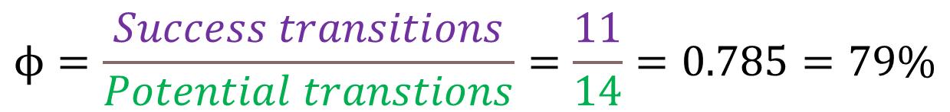
The same but with multiple animals
Animal | State over 8 years
Pear | 11110000
Bolt | 01111100
Ashyl | 00111110
Steps
Count number of successful transitions
11
Count number of total transitions
14
Divide success by total
Animal | State over 8 years
Pear | 11110000
Bolt | 01111100
Ashyl | 00111110
Animal | State over 8 years
Pear | 11110000
Bolt | 01111100
Ashyl | 00111110
$$ϕ=\frac{Success transitions}{Potential transtions}=\frac{11}{14}=0.785=79\%$$

Slide 12
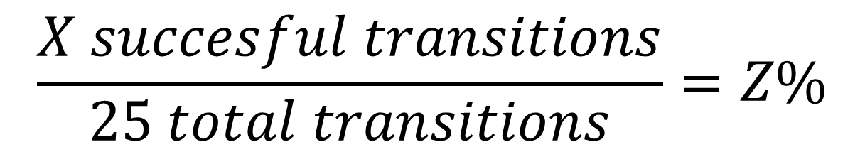
Pop quiz
Are you awake?
Yes
No, but yes
There are 25 students in the class.
Assume all joined at start and we have perfect detection – if you are “awake” you can answer the poll.
Number of students with each capture history;
11 = n =
10 = 25-n =
$$\frac{X succesful transitions}{25 total transitions}=Z\%$$

Slide 13
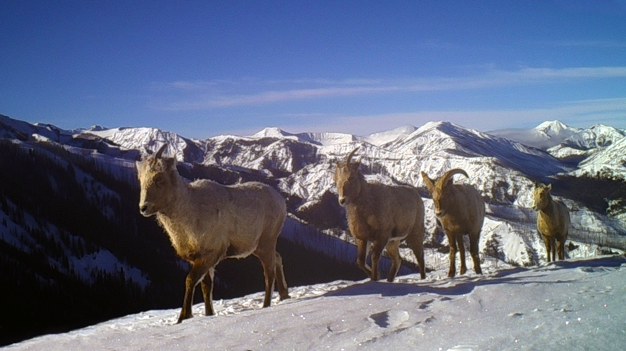
We work with wild animals, not pets

Slide 14
My dog’s life
2018
2019
2020
2021
2022
2023
2024
2025
Φ
Φ
Φ
Φ
Near perfect detection because I see my dog almost every new year
Alive
Dead
Stochastic process (i.e. a biased coin flip)
Φ
Survival probability (i.e. the probability of the biased coin flip)
Deterministic process (i.e. certain)

Slide 15
Individual capture history for a pet
Alive
State process
Dead
Seen
Observation process
Not seen
Stochastic process (i.e. a biased coin flip)
Deterministic process (i.e. certain)

Slide 16
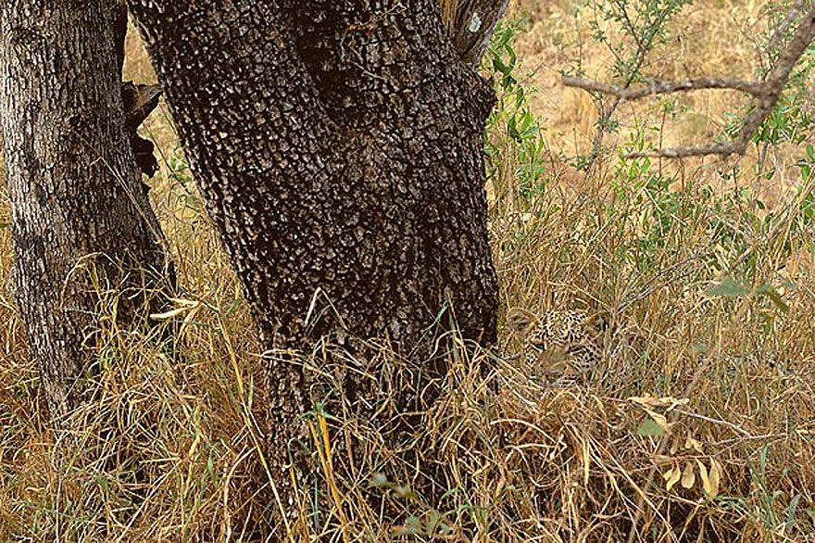
Our old friend, incomplete registration

Slide 17
Individual capture history for a leopard
Alive
State process
Dead
Seen
Observation process
Not seen
Stochastic process (i.e. a biased coin flip)
Deterministic process (i.e. certain)

Slide 18
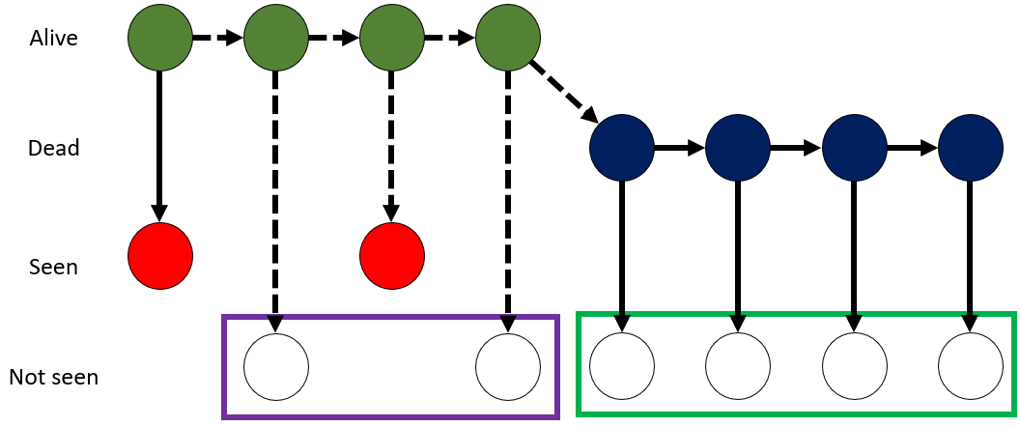
Individual capture history for a leopard
The actual states (alive/dead) of this leopard are;
AAAADDDD
Our observations of the leopard are;
10100000
We can say for sure that the animal was alive in the 2nd year
10100000
No zombie animals

Slide 19
We need to distinguish mortality and non-detection
Split analysis into two parts
State model
Observation model
State model tries to figure out if an individual survived between any two given times
Survival probability (Φ) is between two points in times
Observation model tries to figure out if an individual was recaptured at a given time
Recapture probability (P) is for a single point in time, after the first capture

Slide 20
State process model
Alive
State process
Dead
State model tries to figure out if an individual is alive at any given time (e.g. years)
If animal alive in previous year (1),
Multiply state with Φ
1 * 0.7 = 0.7
Leopard can to survive into next year
If it was dead in previous year (0),
Multiply state with Φ
0 * 0.7 = 0
Leopard cannot survive into next year

Slide 21
Observation process model
Seen
Observation process
Estimated in pretty much exactly the same way as in closed CMR, just conditioned on whether an animal was alive or dead (i.e. the state)
Not seen
Observation model tries to estimate recapture rate conditional on if it was alive to be captured(e.g. years)
If animal was alive (1),
Multiply state with p
1 * 0.3 = 0.3
30% to recapture the leopard
Because it is alive and can be caught
If animal was dead (0),
Multiply state with p
0 * 0.3 = 0
0% to recapture the leopard
Because it is dead

Slide 22
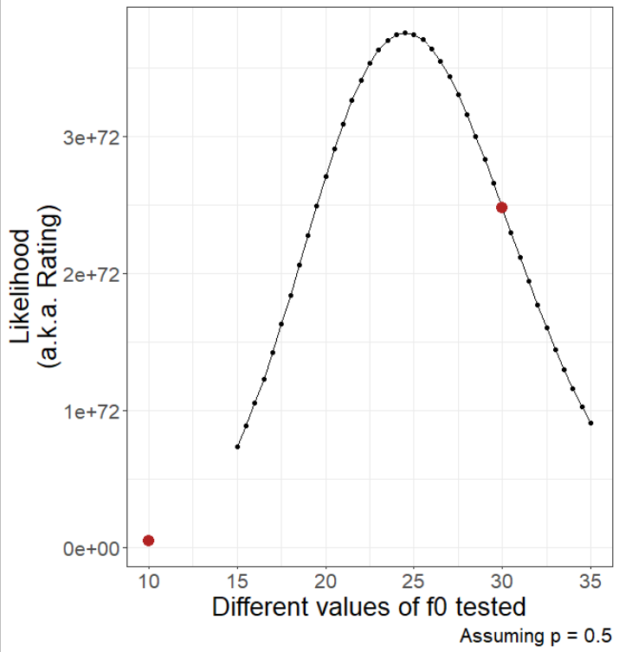
Still using MLE
Exactly the same approach we used for estimating parameters in the closed CMR models
MLE will try a variety of values for both Φ (survival) and P (recapture)
And will report the most likely survival and recapture probabilities

Slide 23
How we use observed to estimate unobserved
Data (observed)
CH_{t} = | 1 | 1 | 0 | 1 | 0 | 0 | 0 | 0
Parameters (unobserved)
Φ_{t} = | Φ₁ | Φ₂ | Φ₃ | Φ₄ | Φ₅ | Φ₆ | Φ₇
P_{t} = | P₁ | P₂ | P₃ | P₄ | P₅ | P₆ | P₇

Slide 24
With multiple individuals
Data (observed)
CH_{t} = | 1 | 1 | 0 | 1 | 0 | 0 | 0 | 0
 | 1 | 0 | 1 | 1 | 1 | 0 | 1 | 0
 | 1 | 1 | 1 | 0 | 0 | 1 | 0 | 0
Parameters (unobserved)
Φ_{t} = | Φ₁ | Φ₂ | Φ₃ | Φ₄ | Φ₅ | Φ₆ | Φ₇
 | Φ₁ | Φ₂ | Φ₃ | Φ₄ | Φ₅ | Φ₆ | Φ₇
 | Φ₁ | Φ₂ | Φ₃ | Φ₄ | Φ₅ | Φ₆ | Φ₇
P_{t} = | P₁ | P₂ | P₃ | P₄ | P₅ | P₆ | P₇
 | P₁ | P₂ | P₃ | P₄ | P₅ | P₆ | P₇
 | P₁ | P₂ | P₃ | P₄ | P₅ | P₆ | P₇

Slide 25
What is an open population?
First survey
Time between surveys
Second survey
If a population is open, we assume that reproduction or death occurs (more on this next week)

Slide 26
Each year, there is a new individuals (i.e. cohorts)
Parameters (unobserved)
Φ_{t} = | Φ₁ | Φ₂ | Φ₃ | Φ₄ | Φ₅ | Φ₆ | Φ₇
 | Φ₁ | Φ₂ | Φ₃ | Φ₄ | Φ₅ | Φ₆ | Φ₇
 | Φ₁ | Φ₂ | Φ₃ | Φ₄ | Φ₅ | Φ₆ | Φ₇
 | NA | Φ₂ | Φ₃ | Φ₄ | Φ₅ | Φ₆ | Φ₇
 | NA | NA | Φ₃ | Φ₄ | Φ₅ | Φ₆ | Φ₇
 | NA | NA | NA | Φ₄ | Φ₅ | Φ₆ | Φ₇
Φ_{t} = | Φ₁ | Φ₂ | Φ₃ | Φ₄ | Φ₅ | Φ₆ | Φ₇
 | Φ₁ | Φ₂ | Φ₃ | Φ₄ | Φ₅ | Φ₆ | Φ₇
 | Φ₁ | Φ₂ | Φ₃ | Φ₄ | Φ₅ | Φ₆ | Φ₇
Data (observed)
CH_{t} = | 1 | 1 | 0 | 1 | 0 | 0 | 0 | 0
 | 1 | 0 | 1 | 1 | 1 | 0 | 1 | 0
 | 1 | 1 | 1 | 0 | 0 | 1 | 0 | 0
 | 0 | 1 | 1 | 1 | 0 | 1 | 0 | 0
 | 0 | 0 | 1 | 0 | 1 | 0 | 0 | 0
 | 0 | 0 | 0 | 1 | 1 | 0 | 0 | 0
CH_{t} = | 1 | 1 | 0 | 1 | 0 | 0 | 0 | 0
 | 1 | 0 | 1 | 1 | 1 | 0 | 1 | 0
 | 1 | 1 | 1 | 0 | 0 | 1 | 0 | 0
 | 0 | 1 | 1 | 1 | 0 | 1 | 0 | 0
 | 0 | 0 | 1 | 0 | 1 | 0 | 0 | 0
 | 0 | 0 | 0 | 1 | 1 | 0 | 0 | 0
CH_{t} = | 1 | 1 | 0 | 1 | 0 | 0 | 0 | 0
 | 1 | 0 | 1 | 1 | 1 | 0 | 1 | 0
 | 1 | 1 | 1 | 0 | 0 | 1 | 0 | 0
P_{t} = | P₁ | P₂ | P₃ | P₄ | P₅ | P₆ | P₇
 | P₁ | P₂ | P₃ | P₄ | P₅ | P₆ | P₇
 | P₁ | P₂ | P₃ | P₄ | P₅ | P₆ | P₇
P_{t} = | P₁ | P₂ | P₃ | P₄ | P₅ | P₆ | P₇
 | P₁ | P₂ | P₃ | P₄ | P₅ | P₆ | P₇
 | P₁ | P₂ | P₃ | P₄ | P₅ | P₆ | P₇
 | NA | P₂ | P₃ | P₄ | P₅ | P₆ | P₇
 | NA | NA | P₃ | P₄ | P₅ | P₆ | P₇
 | NA | NA | NA | P₄ | P₅ | P₆ | P₇

Slide 27
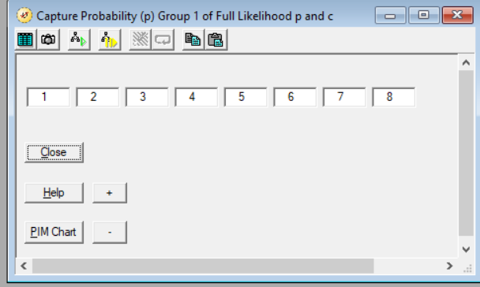
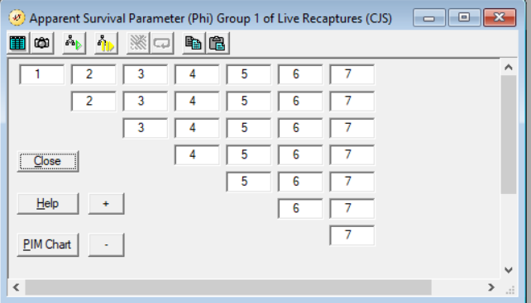
This cohort structure is reflected in MARK
Closed CMR with 1 cohort
Open CMR with > 1 cohorts

Slide 28
tl;dr
Having identified a population trend
Question becomes what is driving that trend
To investigate if survival is causing change, we use open CMR models
We can estimate survival fairly easily when we have complete registration
E.g. for pets
But when we will not recapture every individual every time we trap
We need to take the observation process into account
Open CMR combined both the state process (alive/dead) and the observation process (seen/not seen) to estimate survival

